Slide 1
Markov Quantal Response Equilibrium and a Homotopy Method
2020.07.06.
POSTECH
김병준

Slide 2
Main Topic
“We introduce a model in which preventive healthcare cost affects individual welfare through longevity and analyze how this longevity externality from the prevention rises both inter-country inequality and intra-country inequality, in the old-ages of developed countries.“
Preventive healthcare fosters both inter-country inequality and intra-country inequality, for elders.

Slide 3
Methodology
Comparative analysis of PC model & NPC model
In the preventive-cost (PC) model, the preventive cost reduce both mortality & morbidity
The no-preventive-cost (NPC) model is a baseline model without prevention
We compare the coefficient of variation of both models’ indirect utility
Principal findings
Inter-country inequality
The PC model has higher value of the coefficient of variation in the indirect utility value than the NPC model
We divide 24 countries into High HDI group and Low HDI group, and there is significant heterogeneity between two groups
Intra-country inequality
EIS heterogeneity, not wealth distribution, is the main channel of intra-country inequality from prevention

Slide 4
Contents
Backgrounds
Literatures
Models
- The no-preventive-cost (NPC) model
- The preventive-cost (PC) model
Numerical Implications
- Data
- Inter-country Inequality
- Intra-country Inequality

Slide 5
Background
Old-age inequalities?
13.5% of individual over 65 live in relative income poverty
The income inequality over the age of 65 in OECD countries has hardly changed in recent decades*
Consumption-based approach in old-age inequalities
Most studies about inequality focus on economic gain, or income growth
Public transfers (earning-related pensions, resource-tested benefits) and private occupational transfers (pensions, severance payments, death grants) account for 2/3 of the total income for older people**
It would be more reasonable to measure inequality of the elder by consumption
Longevity externality from prevention
Life expectancy is increased through preventive healthcare such as exercise, immunization, regular checkups, and sufficient nutrition.
The change in life expectancy leads to a price change of mortality contingent claims.
*, **: OECD (2019). Pensions at a glance 2019 - OECD and G20 Indicators.

Slide 6
Literatures
1) Economic Welfare, Inequality, and Healthcare
2005, Becker et al., American Economic Review Analyzed the evolution of cross-country inequality with considering both the quantity and quality of life by longevity
2006, Murphy and Topel, Journal of Political Economy
Measure the economic gain from the extension of the life expectancy
2007, Well, Quarterly Journal of Economics
Estimate the effect of health on GDP per capita
2) Longevity Externality
1998, Philipson and Becker, Journal of Political Economy Savings and longevity impacts of mortality contingent claims (Externality)
2015, Kuhn et al., Journal of Economic Theory A life-cycle model with the simultaneous choice of healthcare and retirement together with consumption

Slide 7
Literatures
3) Lifetime portfolio problem with longevity
2007, Hall and Jones, Quarterly Journal of Economics
How health spending affects lifetime income and overall utility, taking into account the marginal utility of life extension and marginal utility of consumption
2014, Prettner and Canning, Economic Theory
How longevity change affects interest, consumption-saving, retirement in DSGE
2015, Jang et al. Economic Theory
Present the longevity related lifetime model with complete insurance, and partial insurance (Original framework of this paper)
2016, Yogo, Journal of Monetary Economics A life-cycle model considering a retiree who faces stochastic health depreciation and chooses consumption, health expenditure, and the allocation of wealth between bonds, stocks, and housing

Slide 8
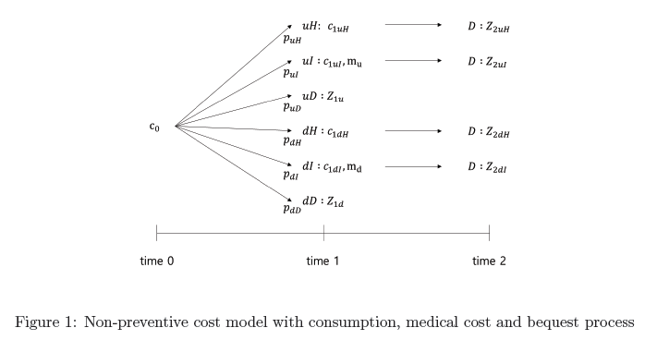
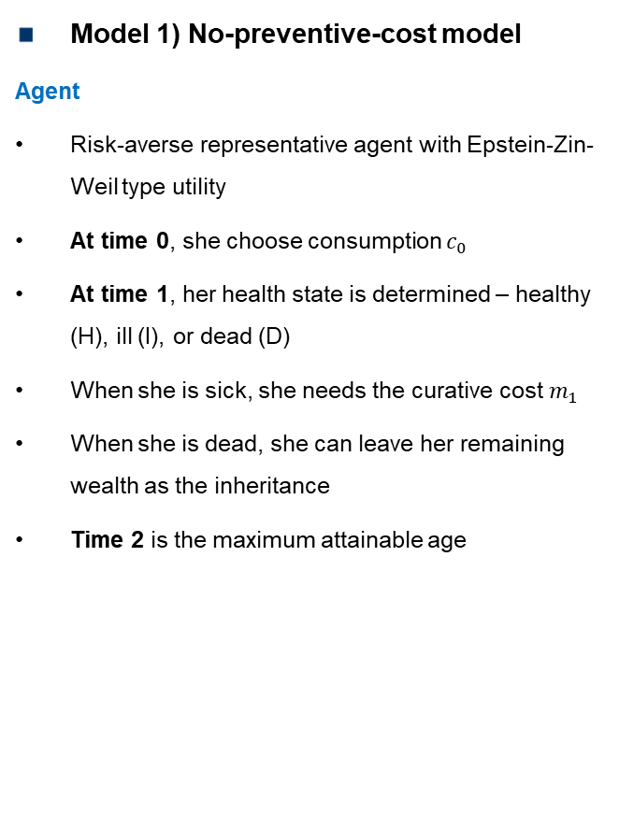
Model
Model 1) No-preventive-cost model
Agent
Risk-averse representative agent with Epstein-Zin-Weil type utility
At time 0, she choose consumption $c_{0}$
At time 1, her health state is determined – healthy (H), ill (I), or dead (D)
When she is sick, she needs the curative cost $m_{1}$
When she is dead, she can leave her remaining wealth as the inheritance
Time 2 is the maximum attainable age

Slide 9
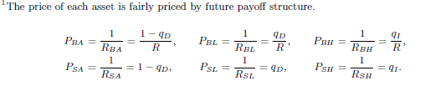
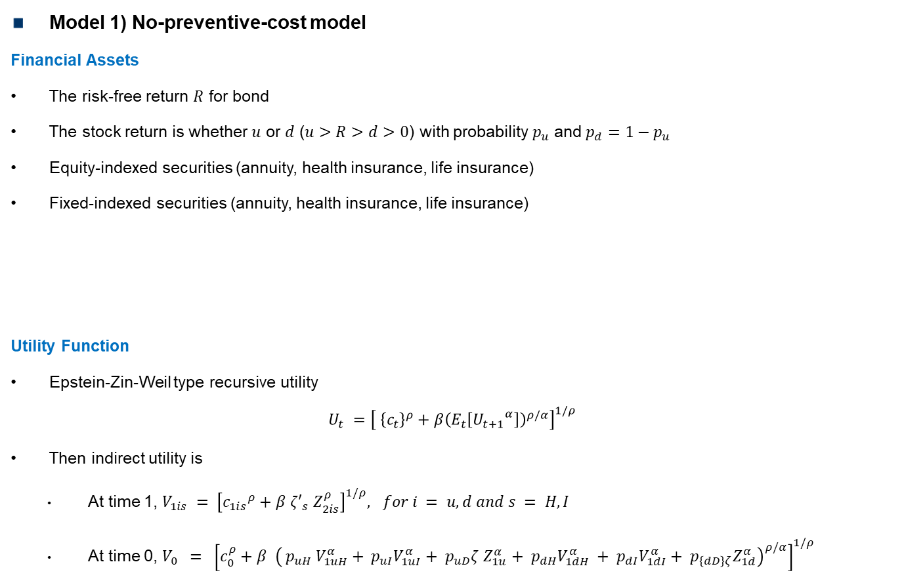
Model
Model 1) No-preventive-cost model
Financial Assets
The risk-free return $R$ for bond
The stock return is whether $u$ or $d$ ($u>R>d>0$) with probability $p_{u}$ and $p_{d}=1−p_{u}$
Equity-indexed securities (annuity, health insurance, life insurance)
Fixed-indexed securities (annuity, health insurance, life insurance)
Utility Function
Epstein-Zin-Weil type recursive utility
$$U_{t} ={\left[ {\left\{c_{t}\right\}}^{ρ}+β{\left(E_{t}\left[{U_{t+1}}^{α}\right]\right)}^{ρ/α}\right]}^{1/ρ}$$
Then indirect utility is
At time 1, $V_{1is} = {\left[{c_{1is}}^{ρ}+β ζ′_{s} Z_{2is}^{ρ}\right]}^{1/ρ}, for i = u,d and s = H, I$
At time 0, $V_{0} = {\left[c_{0}^{ρ}+β {\left( p_{uH} V_{1uH}^{α}+ p_{uI}V_{1uI}^{α}+ p_{uD}ζ Z_{1u}^{α}+ p_{dH}V_{1dH}^{α} + p_{dI}V_{1dI}^{α}+ p_{\left\{dD\right\}ζ}Z_{1d}^{α}\right)}^{ρ/α}\right]}^{1/ρ}$

Slide 10
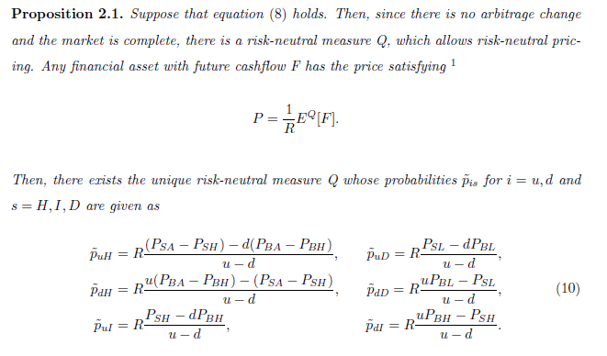
Model
Model 1) No-preventive-cost model
The Risk-Neutral Measure

Slide 11
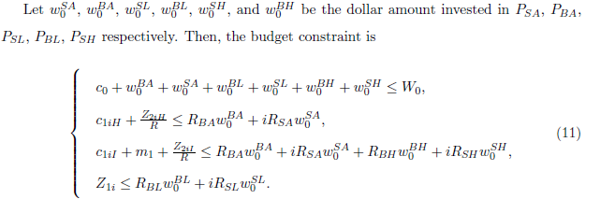
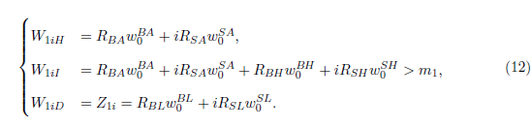
Model
Model 1) No-preventive-cost model
Budget Constraints
Wealth Dynamics

Slide 12
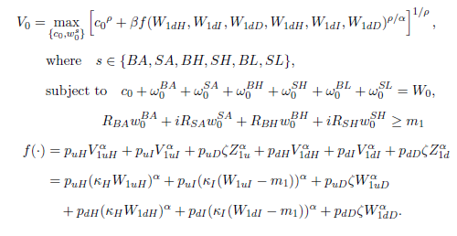
Model
Model 1) No-preventive-cost model
Optimization Problem

Slide 13
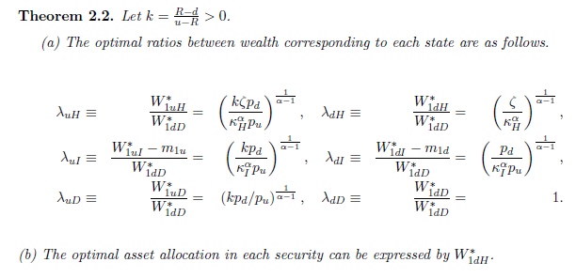
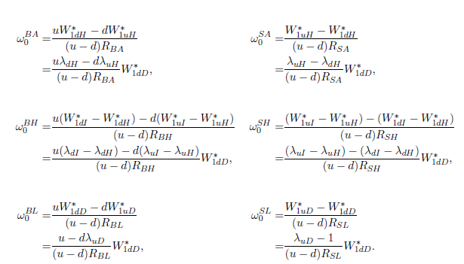
Model
Model 1) No-preventive-cost model

Slide 14
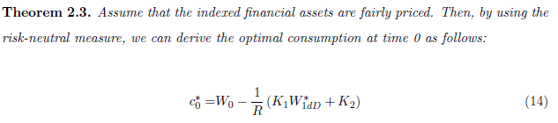
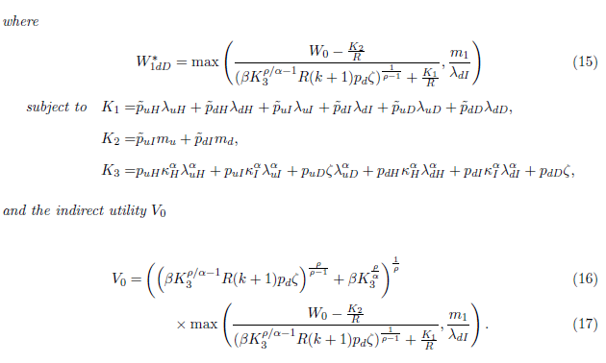
Model
Model 1) No-preventive-cost model

Slide 15
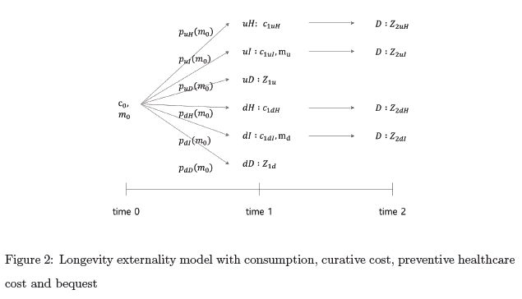
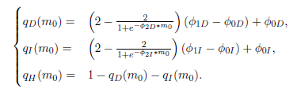
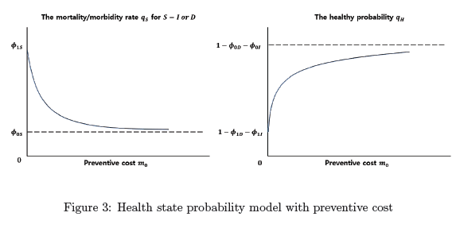

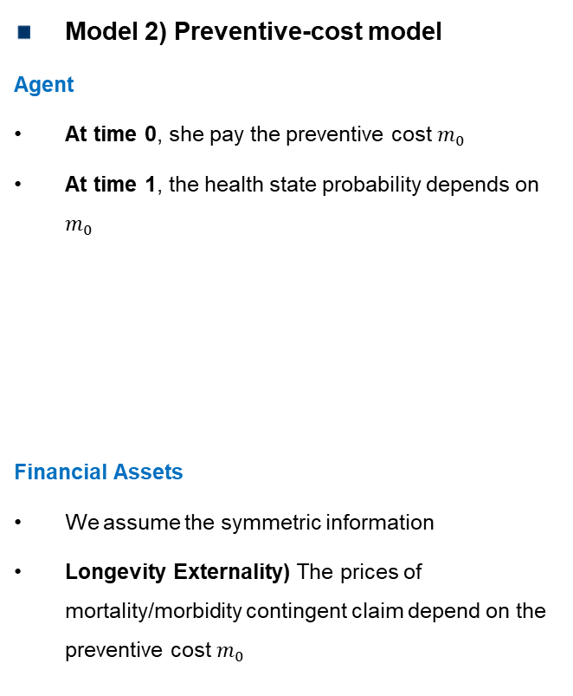
Model
Model 2) Preventive-cost model
Agent
At time 0, she pay the preventive cost $m_{0}$
At time 1, the health state probability depends on $m_{0}$
Financial Assets
We assume the symmetric information
Longevity Externality) The prices of mortality/morbidity contingent claim depend on the preventive cost $m_{0}$

Slide 16
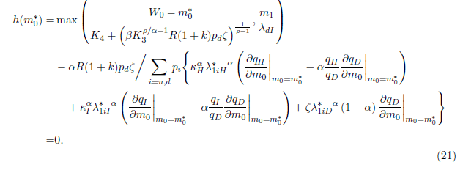
Model
Model 2) Preventive-cost model

Slide 17
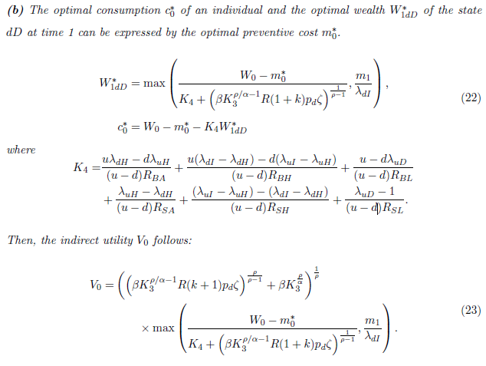
Model
Model 2) Preventive-cost model

Slide 18
Model
Model 2) Preventive-cost model
The PC model
The NPC model

Slide 19
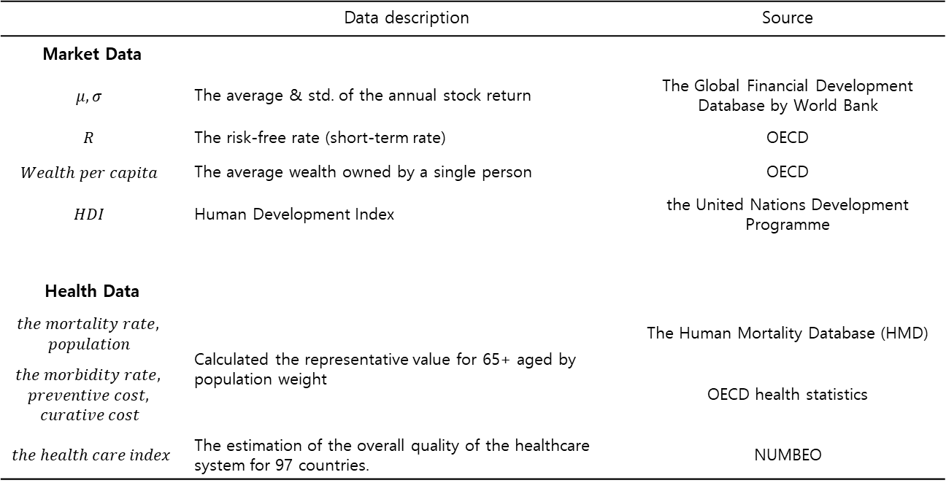
Numerical Implications
Data
Period: 2010 -2017
Public cross-country data for three categories
 | Data description | Source
Market Data
$$μ, σ$$ | The average & std. of the annual stock return | The Global Financial Development Database by World Bank
$$R$$ | The risk-free rate (short-term rate) | OECD
$$Wealth per capita$$ | The average wealth owned by a single person | OECD
$$HDI$$ | Human Development Index | the United Nations Development Programme
Health Data
$$the mortality rate,$$ $$population$$ | Calculated the representative value for 65+ aged by population weight | The Human Mortality Database (HMD)
$$the morbidity rate,$$ $$preventive cost,$$ $$curative cost$$ |  | OECD health statistics
$the health care index$ | The estimation of the overall quality of the healthcare system for 97 countries. | NUMBEO

Slide 20

Numerical Implications
Data
Characteristics of the agent
The elasticity of intertemporal substitution on consumption (EIS) $ψ=0.5 or 2$
The risk aversion $γ=3$
The bequest motive $ζ=0.9$
Parameter calibration in the health state probability model
$φ_{0D}, φ_{1D}, φ_{2D}, φ_{0I}, φ_{1I}, φ_{2I}$
Least square minimization (Huber Loss)
Suggest a two-step optimization technique
1) Adaptive grid-search (reduce candidate)
2) Trust Region Reflective algorithm

Slide 21
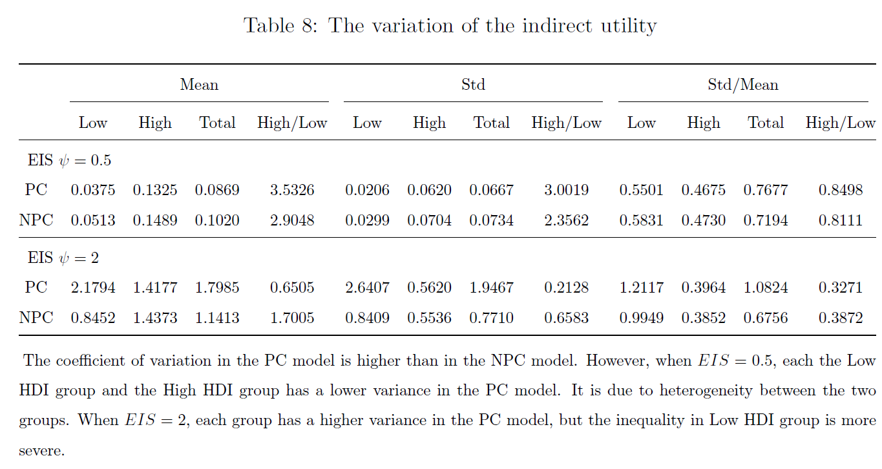
Numerical Implications
Inter-country Inequality
Inequality measure: the coefficient of variation (=average/standard deviation)
The PC model has higher value than the NPC model (more inequality)
The higher the EIS, the more heterogeneity between Low HDI group and High HDI group

Slide 22
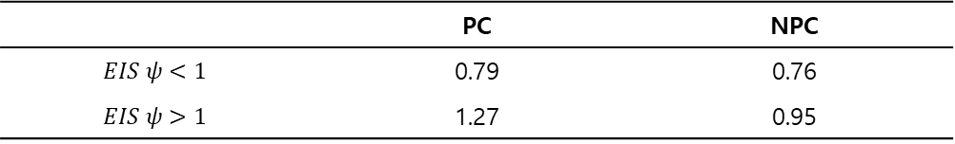
Numerical Implications
Intra-country Inequality
Inequality measure: the coefficient of variation (=average/standard deviation)
For set of uniformly distributed EIS values,
The PC model has higher coefficient of variation than the NPC model
The set of initial wealth values does not show significant impact of the prevention on inequality
 | PC | NPC
$$EIS ψ<1$$ | 0.79 | 0.76
$$EIS ψ>1$$ | 1.27 | 0.95

Slide 23
End of Document

